Slide 1
07 | Introduction to Authentication
Jon Galloway | Technical Evangelist
Christopher Harrison | Content Developer

Slide 2
Module Overview
ASP.NET Identity Overview
Individual User Accounts
Identity Extensibility
Federated Accounts

Slide 3
ASP.NET Identity Overview

Slide 4
From Membership to Identity
ASP.NET 1.1 N/A
ASP.NET 4 Simple Membership
ASP.NET 4.5 One ASP.NET Identity
ASP.NET 2.0 Membership Provider
ASP.NET 4/4.5 Universal Providers
Migrating? Check here: www.asp.net/identity/overview/migrations

Slide 5
ASP.NET Identity
One ASP.NET Identity system
Ease of plugging in profile data about the user
Persistence control
Unit testability
Role provider
Claims Based
Social Login Providers
Windows Azure Active Directory
OWIN Integration
NuGet package

Slide 6
Identities & Scenarios
Identity | Usage Scenarios
Individual User Accounts (ASP.NET Identity with or w/o Social Identities) | Internet apps, small and medium businesses, consumer apps
Active Directory (AD) | On-premises enterprise apps and users (LAN/VPN)
Active Directory Federation Services (ADFS) | On-premises enterprise apps with remote users
Azure Active Directory (AAD) | Cloud-based enterprise apps

Slide 7
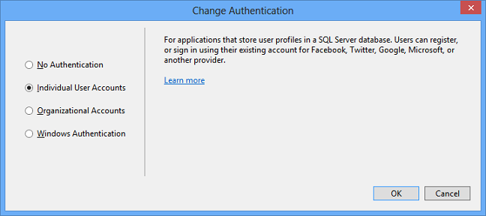

Slide 8
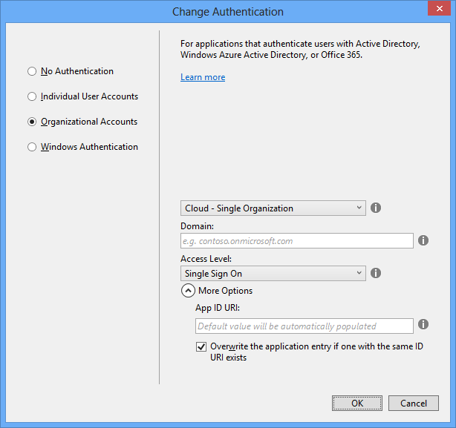

Slide 9
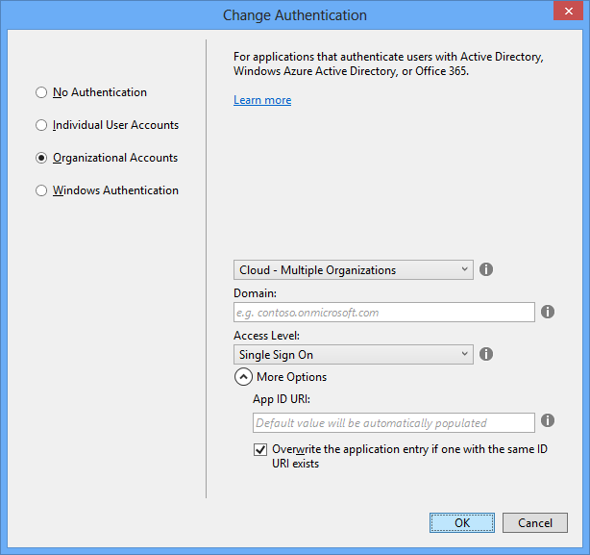

Slide 10
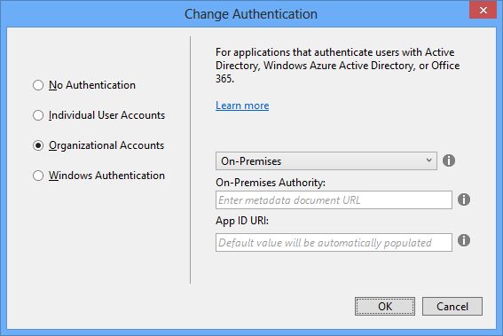

Slide 11
Terminology
Identity / Credentials
Authentication / Authorization
Roles / Claims
Two Factor Authentication (2FA)
Passive / Active Protocols

Slide 12
Individual User Accounts

Slide 13
Individual User Accounts

Slide 14
ASP.NET Identity - One to Rule Them
Usable across all ASP.NET Frameworks
MVC, Web Forms, Web API, etc.
Accessible from web, desktop, and mobile clients
Manage users internally or use external providers
Customizable scheme and persistency (Can be relational database or NoSql storage)
Supports both roles and claims
Authentication based on OWIN middlewares

Slide 15
What’s New in Identity 2.0? (Highlights)
Two-Factor Authentication
Account Lockout
Account confirmation
Password reset
Sign-out everywhere
Enhanced password validator
IQueryable for users and roles
Everything that’s new: bit.ly/aspnet-identity-2-rtm

Slide 16
ASP.NET Identity with MVC
Notes:
SPA with Web API Authentication
MVC controller for sign-in and sign-out
Role-based and claim-based authorization
(optional - Show ThinkTecture IdentityManager to manage identities)
ASP.NET Identity features:
Change persistence database to NoSQL
Control password strength
Account confirmation
Two Factor authentication
Single sign out

Slide 17
ASP.NET Identity and External Providers
Why force users to create yet another identity?
ASP.NET Identity supports external social providers (Facebook, Google, Microsoft, Twitter)
Pluggable using OWIN middlewares
Supports storing additional user information
Single user can have multiple social identities

Slide 18
ASP.NET Identity with Social Providers
Notes:
Connect to Microsoft & Google
Add custom full name & extract personal information from Google

Slide 19
Identity Extensibility

Slide 20
ASP.NET Extensibility
Profile
Quick look at extensibility options

Slide 21
ASP.NET Identity Extensibility
Notes:
SPA with Web API Authentication
MVC controller for sign-in and sign-out
Role-based and claim-based authorization
(optional - Show ThinkTecture IdentityManager to manage identities)
ASP.NET Identity features:
Change persistence database to NoSQL
Control password strength
Account confirmation
Two Factor authentication
Single sign out

Slide 22
Federated Accounts

Slide 23
On-Premises and Cloud with AD, ADFS, and AAD

Slide 24
What Are Your Options? Identities & Technologies
Identity | Technology
Individual User Accounts | ASP.NET Identity, Social Providers One ASP.NET Identity System Many new features in ASP.NET Identity 2.0 such as 2FA.
Active Directory (AD) | IIS + Windows Authentication
Active Directory Federation Services (ADFS) | WS-Federation middleware (Passive) OAuth 2 middleware (Active)
Azure Active Directory (AAD) | Same as for ADFS OpenID Connect

Slide 25
Identities & Scenarios
Identity | Usage Scenarios
Individual User Accounts (ASP.NET Identity with or w/o Social Identities) | Internet apps, small and medium businesses, consumer apps
Active Directory (AD) | On-premises enterprise apps and users (LAN/VPN)
Active Directory Federation Services (ADFS) | On-premises enterprise apps with remote users
Azure Active Directory (AAD) | Cloud-based enterprise apps

Slide 26
Resources
Slides & Samples:
http://1drv.ms/1kDVjEt
All About ASP.NET Identity
http://asp.net/identity
http://curah.microsoft.com/55636/aspnet-identity
Code
http://aspnetidentity.codeplex.com
http://katanaproject.codeplex.com
http://github.com/thinktecture
Blogs and Docs
http://blogs.msdn.com/b/webdev
http://blogs.technet.com/b/ad
http://asp.net/identity/overview/migrations
http://azure.microsoft.com/en-us/documentation/services/active-directory

